Slide 1











Green University of Bangladesh
Department Of Computer Science and Engineering(CSE)
FACULTY OF SCIENCE AND ENGINEERING
Course Title: Data Structure Lab Course Code: CSE-106 Section: DG
Course Instructor
Presented By
Sagufta Sabah Nakshi
Md. Mahim Hossain
Lecturer
ID : 221902082

Slide 2




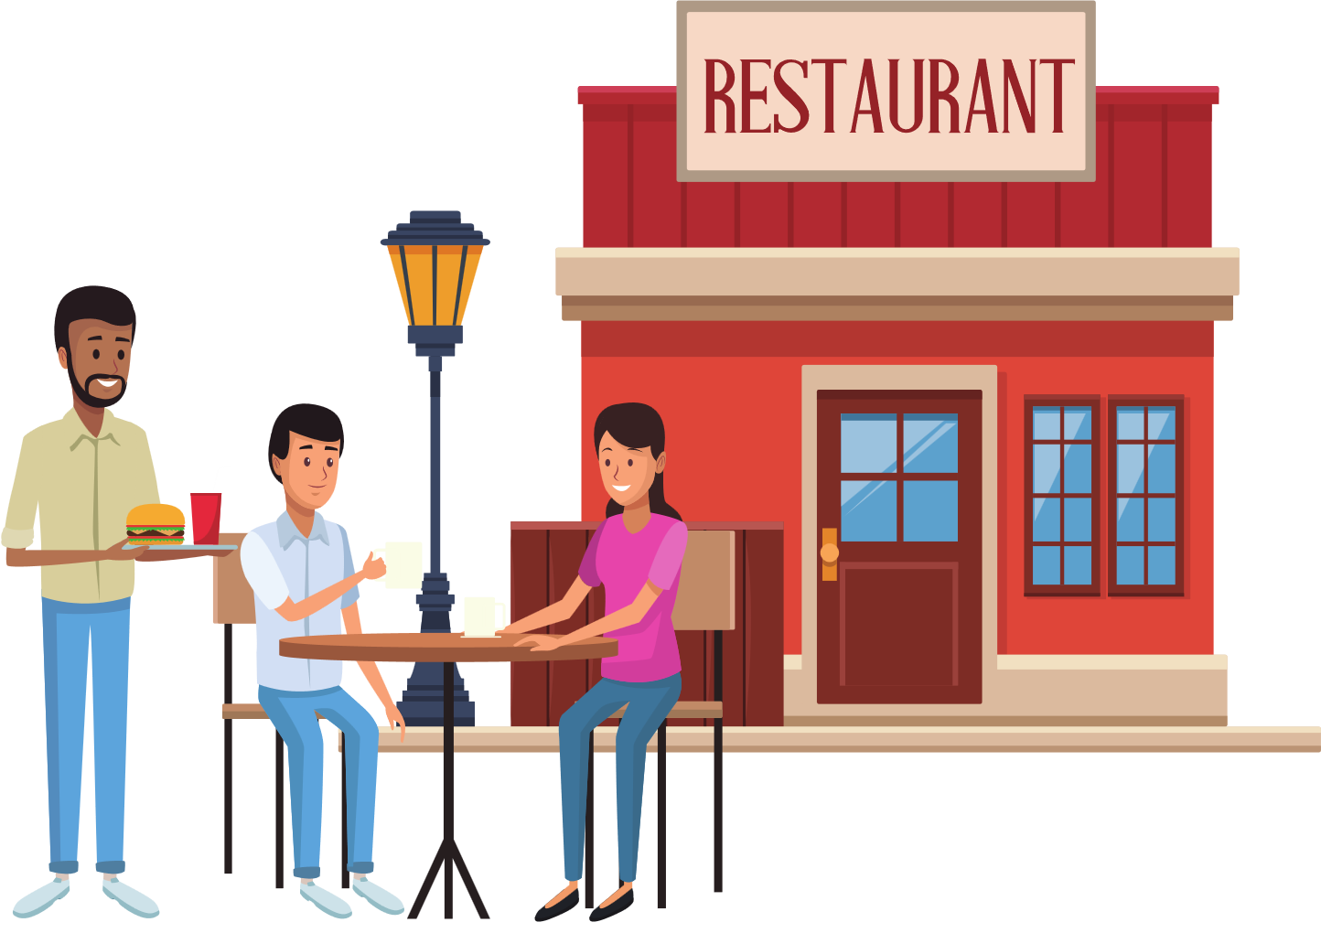


Restaurant Management Software

Slide 3


Outline of the presentation :
Introduction.
Section
Uses in Real life & Future plan
Conclusion
Reference

Slide 4
Introduction
The computerization of the restaurant management software will not only improves the efficiency of the restaurant workers but will also help the customers to get all things at the right price.

Slide 5

Section
Admin Section
Customer Section
Exit Section

Slide 6

Uses in Real Life :
This program can be uses in food courts or restaurants to maintain the food orders. Although this program contains a few items in list the list can be bigger and with more options as necessary
Future Plan:
Upgrading this program we can create more suitable restaurant management software. Which can ever be capable of keeping record of previous records. This can be used in all for automated home delivery system.
Uses in Real life
&
Future plan :

Slide 7
Conclusion
This program is full of potential to help people managing orders and saving times. It can be helpful for both customers and restaurant owner or manager.

Slide 8

Reference :
Website :
www.learncpp.com
www.youtube.com
www.github.com

Slide 9









